Slide 1

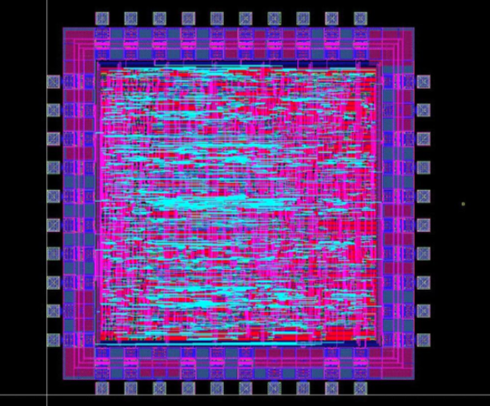
ECE 337 Project Canny Edge Detection Design Review
Oluwatosin Adeosun, Sukhyun Hong,
Eric Nielsen, Jiyuan Zhao

Slide 2
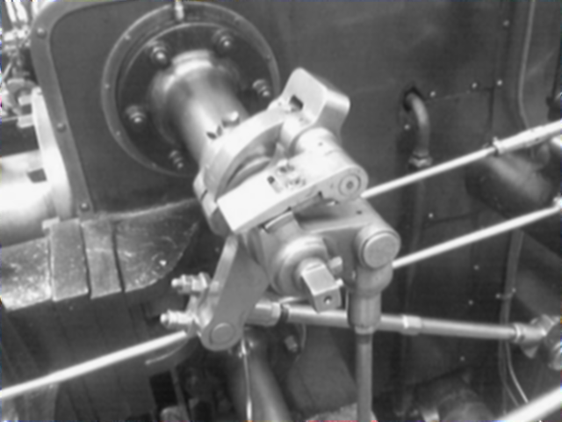
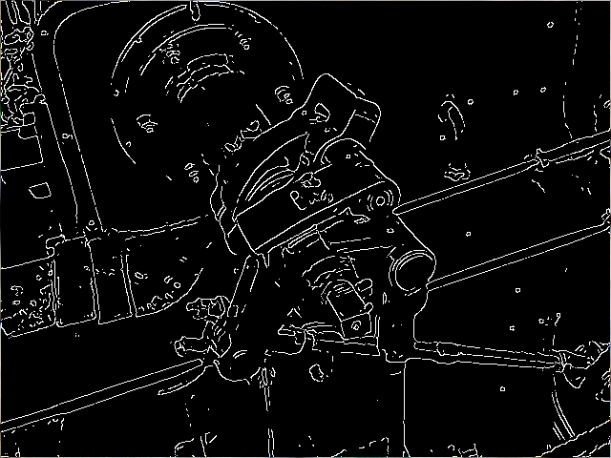
Project Overview
Edge detection using Canny algorithm
ASIC implementation using pipelining
Input/output bitmap images
Four main functional blocks
Image smoothing
Gradient and magnitude calculation
Directional non-maximal suppression
Hysteresis thresholding

Slide 3
System Level Diagram
Output Image
(Bitmap, 128x128 pixels)
Python Script
Python Script
Input Image
(Bitmap, 128x128 pixels)
Off-Chip SRAM
(Cypress, CY7C1018DV33)
Read Input Image Data
(AHB-Lite Protocol)
Canny Edge Detection Algorithm
Write Output Image Data
(AHB-Lite Protocol)

Slide 4
Design Flow Chart
Magnitude Calculation Block
Directional Non-Maximal Suppression Block
Input Image
Data
Output Image Data
Image Smoothing Block (Gaussian)
Horizontal & Vertical Gradient Calculation Block
Hysteresis Thresholding

Slide 5
Architecture Diagram

Slide 6
Image Smoothing (Gaussian)

Slide 7
Gradient/Magnitude Calculation

Slide 8
Directional Non-Maximal Suppression

Slide 9
Hysteresis Thresholding

Slide 10
Main Controller

